Slide 1
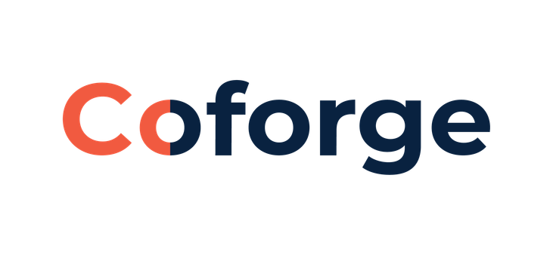


TechCon 2026
QE Track
Team 390-AgentForge
AVaaS :
AI Quality Engineering Platform
Coforge TechCon 2026
Vision Statement: AVaaS is a centralized enterprise AI Quality Hub designed to autonomously test, evaluate, benchmark, and govern AI agents across their lifecycle. Combining zero-integration browser orchestration (Playwright) with Multimodal LLM-as-a-Judge evaluation, AVaaS enables organizations to deploy agentic AI with quantified confidence, security, and ROI.
Industry : QE | Sub-Industry : QA Automation
Title : Agent Validator Platform

Slide 2
TechCon 2026
QE Track
Team 390-AgentForge
Market Limitations vs. The AVaaS Advantage
The Enterprise Testing Gap
The AVaaS Differentiation
Zero-Integration Validation: Tests the live rendered UI using just the deployment URL. No source code modifications or SDKs required.
Multimodal Vision-as-a-Judge: Captures real client-side screenshots to evaluate visual layout, formatting, and semantic accuracy simultaneously.
Autonomous Test Generation: Instantly auto-generates adversarial and edge-case suites directly from raw agent specifications.
Legacy UI Automation (Selenium): Relies on brittle DOM selectors and manual scripting. Cannot evaluate generative reasoning or dynamic text.
Backend Evaluators (DeepEval/LangSmith): Requires heavy SDK instrumentation. Tests backend API payloads but remains completely blind to frontend visual crashes and markdown truncation.

Slide 3
TechCon 2026
QE Track
Team 390-AgentForge
End-to-End Autonomous Validation Pipeline
User/QA Engineer
Web Dashboard (URL)
Phase 1: Autonomous Test Intelligence
Phase 2: Resilient Execution Engine
Phase 3: Dual-Tier Evaluation:
Phase 4: Automated Release Gates
Instantly auto-generates normal, edge-case, and adversarial (jailbreak) suites directly from agent specifications.
Tier 1: Deterministic logic and latency constraints.
Calculates a standardized 0-100 Confidence Score to enforce strict Pass/Fail deployment thresholds.
Headless Playwright orchestration with built-in circuit breakers and SPA hydration handling.
Tier 2: LLM-as-a-Judge (Safety, hallucination detection, business rules).
Web Dashboard/Reports
View Results , Analytics

Slide 4

TechCon 2026
QE Track
Team 390-AgentForge
Value Realization & Business Impact
Expected ROI Indicators
Engineering Effort Reduction: Autonomous prompt-based scenario generation replaces the need for continuous, manual UI test script maintenance.
Release Acceleration: Transitions teams from subjective QA approvals to deterministic, automated Release Gates (e.g., automated PASS/WARN/FAIL status).
Defect Leakage Prevention: Vision-as-a-Judge catches UI-level hallucinations, markdown breaks, and state traps before they impact production users.
0-100
Agent Confidence Score: Instead of subjective Pass/Fail guesses, AVaaS outputs a standardized 0-100 Release Confidence Score based on a weighted evaluation rubric.

Slide 5

TechCon 2026
QE Track
Team 390-AgentForge
Security, Compliance & Privacy Controls
Responsible AI Governance
Platform & Execution Security
Adversarial Defense: Automated injection and jailbreak simulations ensure agents do not leak internal system prompts or bypass safety boundaries.
Verifiable Audit Trails: Every validation run captures full-page visual screenshots, raw text, and token traces to support regulatory compliance.
PII & Privacy Controls: Pre-execution PII redaction and dynamic data masking within the evaluation pipeline.
Execution Resilience: Headless orchestration utilizes built-in circuit breakers and staggered asynchronous loops to safely handle rate limits without crashing.
Secure Deployment: Dockerized infrastructure designed for secure Azure Virtual Machine hosting directly behind enterprise firewalls.

Slide 6
TechCon 2026
QE Track
Team 390-AgentForge
Scaling to a Centralized AI Quality Hub
Phase 1: Pilot Implementations (Current)
Phase 2: DevSecOps Integration & Hub Expansion
Phase 3: Omnichannel & Multi-Agent Orchestration
Integrate AVaaS directly into enterprise GitHub Actions CI/CD pipelines for automated quality governance.
Develop reusable, industry-specific testing templates (e.g., Banking, Healthcare compliance accelerators).
Onboard initial web-based conversational agents.
Establish baseline success metrics (Latency, Token Cost, Confidence Score) against existing QA methods.
Extend testing orchestration beyond web UI to Mobile, API, and voice-based conversational AI.
Validate complex, end-to-end business processes handled by autonomous multi-agent workflows (CrewAI/LangGraph).

Slide 7
TechCon 2026
QE Track
Team 390-AgentForge
Thank
You
Industry : QE | Sub-Industry : QA Automation
Title : Agent Validator Platform

